Slide 1


G.H. RAISONI COLLEGE OF ENGINEERING AND MANAGEMENT, WAGHOLI, PUNE
Department of CSE ( AI & AIML)
Lost and Found App Using Deep Learning
Guide:
Prof. Swati Barik
Name of Projectees
Abhijeet Warale A-01| Arpeet Chandane A-16 | Abhishek Kadam A-03 | Abhishek Kasture A-04

Slide 2
Contents
Introduction
Justifications for Selecting the Title
Problem Statement
Literature Survey
Block Diagram
Expected Result
Work plan
References

Slide 3
Introduction
The Lost and Found Using Deep Learning project introduces an AI-powered system designed to revolutionize the way we handle lost and found items. Key features include:
Utilization of state-of-the-art deep learning models:
BLIP (Bootstrapping Language-Image Pre-training) for advanced image captioning
BERT (Bidirectional Encoder Representations from Transformers) for sophisticated textual matching
Key Components:
Automated process for identifying, describing, and matching lost items with found items
Real-time notification system for potential matches
User-friendly interface for reporting lost items and uploading found items
Scalable solution capable of handling a large number of items and users
Integration of image recognition and natural language processing technologies

Slide 4
Justification For Selecting The Title
Why “Lost and Found Using Deep Learning”?
Addresses a Universal Problem: Losing personal items is a common issue that affects people worldwide, causing stress, inconvenience, and potential financial loss.
Innovative Approach: By leveraging deep learning techniques, the project offers a novel solution to an age-old problem, moving beyond traditional manual systems.
Technological Relevance: The use of cutting-edge AI technologies like BLIP and BERT showcases the practical applications of recent advancements in machine learning.
Efficiency and Scalability: Deep learning models can process and analyze vast amounts of data quickly, making the system highly efficient and scalable for large-scale deployments.
Interdisciplinary Nature: The project combines elements of computer vision, natural language processing, and user interface design, highlighting the versatility of AI applications.

Slide 5
Problem Statement
The Core Problem:
The main challenge is to develop an AI-powered Lost and Found System that automates and optimizes the process of matching lost items with found items using advanced deep learning techniques.
Sub-Problem:
Technical Challenges:
Efficiently analyze and process images of found items
Generate accurate and detailed descriptions of found items using image captioning technology
Compare user-submitted descriptions of lost items with generated captions of found items
Provide a user-friendly interface for reporting lost items and uploading found items
Implement a real-time notification system to alert users of potential matches
Ensure high accuracy in item matching to minimize false positives and improve user satisfaction
Scale effectively to handle a large number of items and users across various locations
Maintain user privacy and data security throughout the process
Reduce the time and effort required to recover lost items compared to traditional manual systems

Slide 6

Literature Survey
Sr. No.
Paper Title
Details of Publication
Findings
Abu Musa Sakib, Sumyia Afnan Mukta and Md. Yakub Hossain -ResearchGate
This paper presents an image captioning model using CNNs and RNNs, trained on the COCO dataset to generate descriptive captions for images
1
Automated Image Captioning System
Akhilesh Kumar Choudhary Bharat Sanchar Nigam Limited -IEEE
This paper introduces the "FindMine" mobile app, which allows users to post and search for lost items by tagging their location and description.
2
Find Mine: Find the Lost Items via Mobile App
Image Captioning:
Transforming
Objects into words
The paper introduces the Object Relation Transformer, which improves image captioning by incorporating spatial relationships between objects using geometric attention.
Simao Herdade, Armin Kappeler, Kofi Boakye, Joao Soares
3

Slide 7
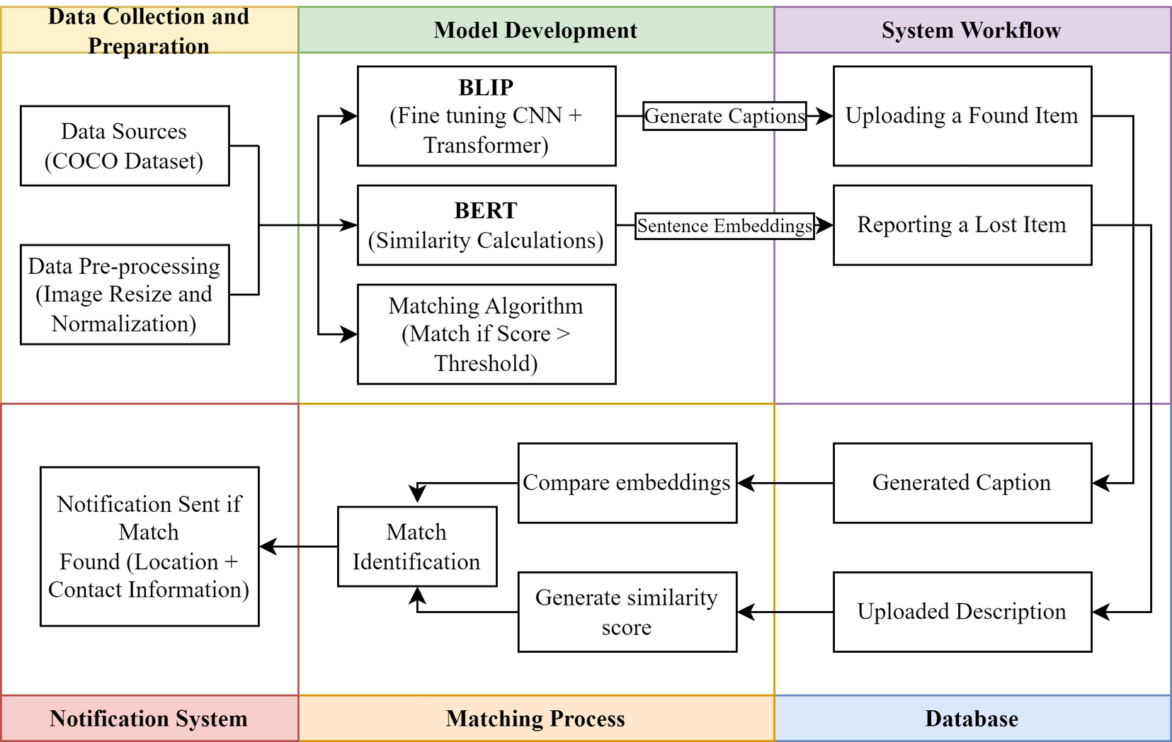
Block Diagram / Flow Chart

Slide 8
Expected Result
Upon successful implementation of the Lost and Found Using Deep Learning system, the following outcomes are anticipated:
Automated Caption Generation:
Highly accurate and detailed descriptions of found items generated by the BLIP model
Consistent quality of captions across various types of items and image qualities
Efficient Database Management:
A well-organized, searchable database of found items, including images, captions, and metadata
Fast retrieval and comparison of items for matching purposes
High Matching Accuracy:
Significant improvement in matching accuracy compared to traditional keyword-based systems
Low false positive rate, ensuring users are not overwhelmed with incorrect matches
Real-Time Notifications:
Instant alerts to users when potential matches for their lost items are found
Reduced time between item loss and recovery
User Satisfaction:
Measurable reduction in time and effort required to find lost items
Positive user feedback on the system's ease of use and effectiveness
Scalability:
Successful handling of a large number of items and users without significant performance degradation
Ability to deploy the system across multiple locations or organizations

Slide 9
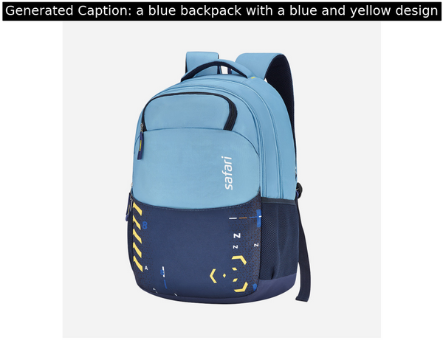
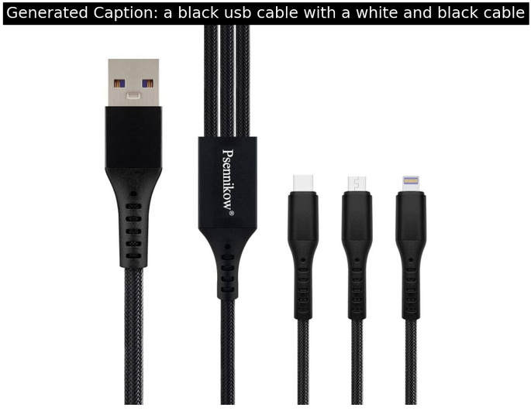
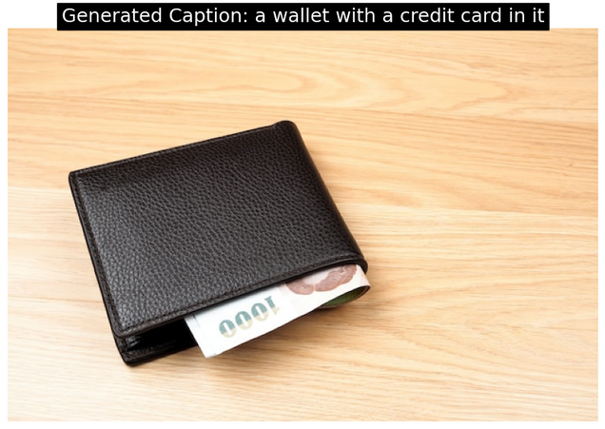

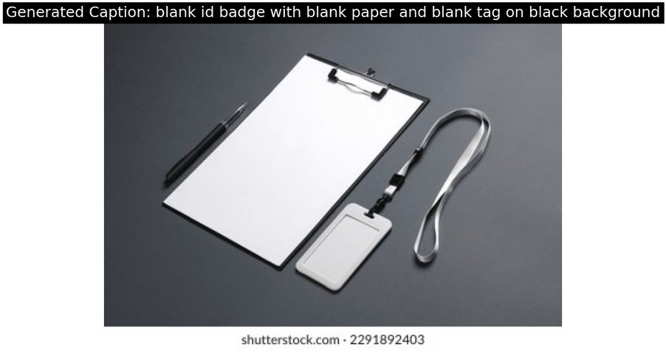
Results

Slide 10
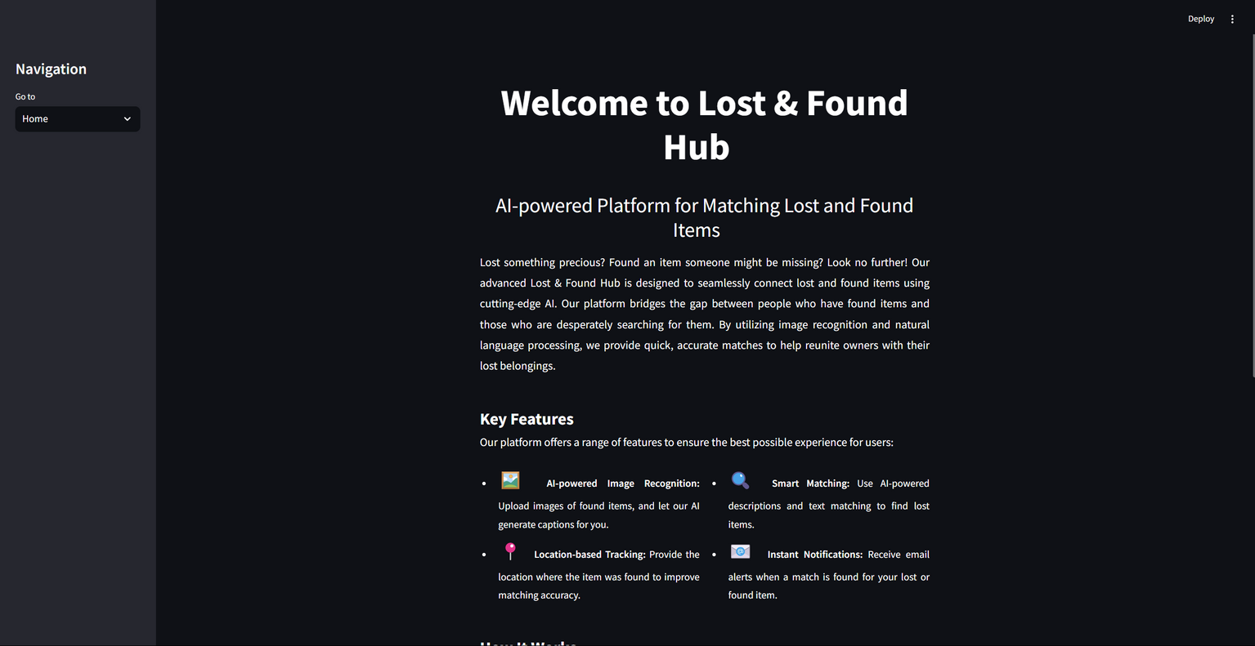
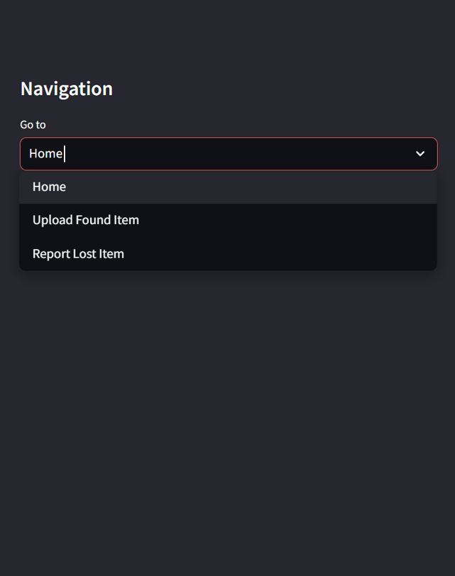
Results - Implementation

Slide 11
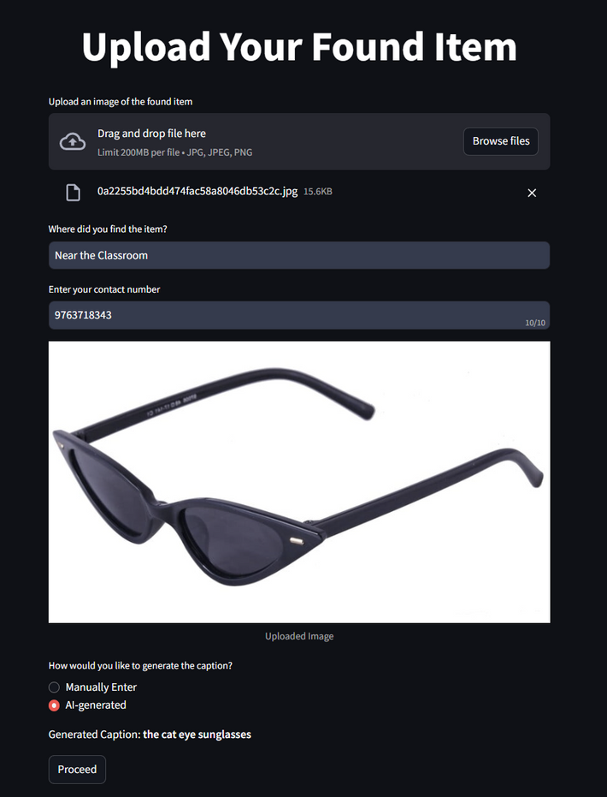
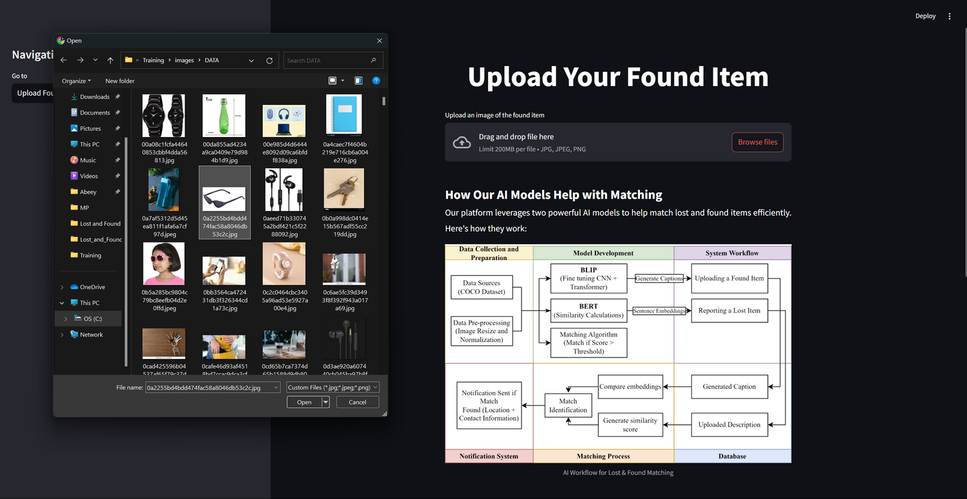
Results - Implementation

Slide 12
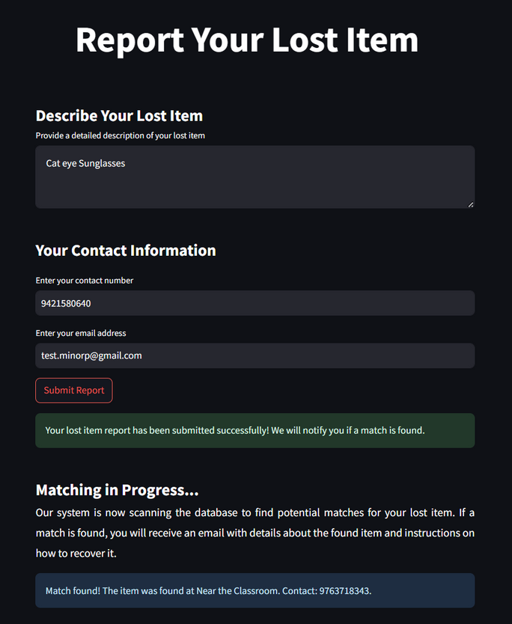
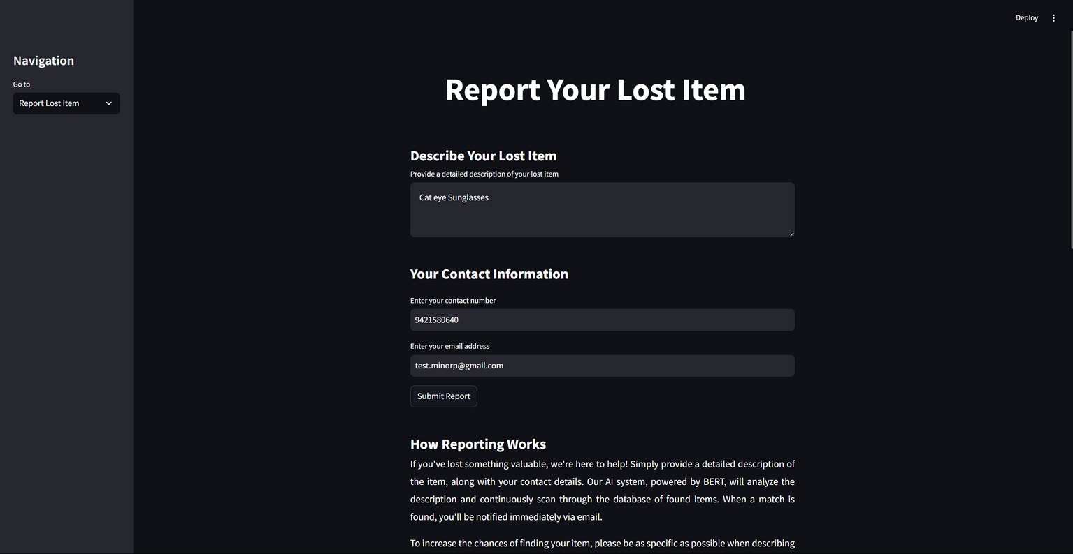
Results - Implementation

Slide 13

Work – Plan
July’24
August’24
Sept’24
Oct’24
Months Activities
Literature Reviews
√ √ √ √
Requirement Analysis
Designing
Experimental Analysis
√ √
√ √ √
Module wise Implementation
Testing and Debugging
√ √
Preparation of Project Report

Slide 14
References
P. Choudhary, A. Choudhary, A. Singh, “Find the Lost Items via Mobile App”, 2021 2nd International Conference on Intelligent Engineering and Management (ICIEM), India, 2021
Sakib, S.Mukta, Md.Hossain, “Automated Image Captioning System”, Independent University, Bangladesh, April 2024
G. Geeta, T. Kirtigadevi, G. Godwin Ponsam, T. Karthik and M. Safa, “Image Captioning .Using Deep Convolutional Neural Networks (CNNs), Journal of Physics: Conferrence Series, Vol. 1712, pp. 012015, Dec. 2020
Weller, Mira, et al. "Lost and Found: Stopping Bluetooth Finders from Leaking Private Information." arXiv preprint arXiv:2005.08208 (2020)
Ortiz, S.A. and Ortiz, L.M., Open Invention Network LLC, 2018. Determining the last location of lost and stolen portable electronic devices when wireless communications access to the lost or stolen devices is lost or intermittent. U.S. Patent 9,860,703.

Slide 15
References
F. Muhammad Shah, M. Humaira, J. Jim, A. S. Ami, and S. Paul, ”Bornon: Bengali Image Captioning with Transformer-based Deep learning approach,” arXiv (Cornell University),Sep,2021
S. Liu, L. Bai, Y. Hu, and H. Wang, ”Image Captioning Based on Deep Neural Networks,” MATEC Web of Conferences, vol. 232, pp. 01052, 2018.
P. Anderson, B. Fernando, M. Johnson, and S. Gould. SPICE: Semantic propositional image caption evaluation. In European Conference on Computer Vision,2016

Slide 16
Thank you !

